Slide 1
Python
Day #4

Slide 2
Agenda
Special Modules
sys
argparse
os and os.path
subprocess
Developing command line applications
Variable length arguments in functions
Generators and Iterators
Decorators and class Decorators
Composition
Delegation
Mixins

Slide 3
Agenda
Managing attributes in Python
Properties and Descriptors
@property
Working with HTML
Working with JSON
Working with Excel
Using the openpyxl module

Slide 4
The sys Module
sys.path
A list of strings that specifies the search path for modules. Initialized from the environment variable PYTHONPATH, plus an installation-dependent default
sys.platform
This string contains a platform identifier that can be used to append platform-specific components to sys.path, for instance
sys.version
A string containing the version number of the Python interpreter plus additional information on the build number and compiler used.

Slide 5
Command Line Arguments
The sys module also provides access to any command-line arguments via sys.argv
sys.argv is the list of command-line arguments
len(sys.argv) is the number of command-line arguments
Command line arguments are extremely useful for chaining different programs where the output of one program is piped into input of another program
Notes:
Are command-line arguments useful? Commands on Unix-based systems are typically programs that take input, perform some function, and send output as a stream of data. These data are usually sent as input directly to the next program, which does some other type of function or calculation and sends the new output to another program, and so on. Rather than saving the output of each program and potentially taking up a good amount of disk space, the output is usually "piped" into the next program as its input.
This is accomplished by providing data on the command line or through standard input. When a program displays or sends output to the standard output file, the result would be displayed on the screenunless that program is also "piped" to another program, in which case that standard output file is really the standard input file of the next program. I assume you get the drift by now!
Command-line arguments allow a programmer or administrator to start a program perhaps with different behavioral characteristics. Much of the time, this execution takes place in the middle of the night and runs as a batch job without human interaction. Command-line arguments and program options enable this type of functionality. As long as there are computers sitting idle at night and plenty of work to be done, there will always be a need to run programs in the background on our very expensive "calculators."

Slide 6
Terminating Execution
The primary way to exit a program immediately and return to the calling program is the exit() function found in the sys module
Syntax: sys.exit()

Slide 7
The argparse Module
The argparse module was added to Python 2.7 as a replacement for optparse
It is the recommended command-line parsing module in the Python standard library
argparse.ArgumentParser() creates the parser object
add_argument() method, which is what we use to specify which command-line options the program is willing to accept
parse_args() method actually returns some data from the options specified
Positional and Optional arguments
parser.add_argument('--optional', action="store_true", default=False)
parser.add_argument('positional', action="store")

Slide 8
Usage Example
import argparse
parser = argparse.ArgumentParser()
parser.add_argument("arg1")
args = parser.parse_args()
print (args.arg1)

Slide 9
File System and Directories
Access to your file system occurs mostly through the Python os module
os module is actually a front-end to the real module that is loaded, a module that is clearly operating system dependent
This "real" module may be one of the following: posix (Unix-based, i.e., Linux, MacOS X, *BSD, Solaris, etc.), nt (Win32), mac (old MacOS), dos (DOS), os2 (OS/2), etc.
You should never import those modules directly
Just import os and the appropriate module will be loaded, keeping all the underlying work hidden from sight
Refer:
https://docs.python.org/3/library/os.html
https://docs.python.org/2/library/os.html

Slide 10
Important Functions in os Module
Function | Purpose
mkdir()/makedirs() | Create directory(ies)
rmdir()/removedirs() | Remove directory(ies)
getcwd()/getcwdu() | Return current working directory/same but in Unicode
listdir() | List files in directory
chroot() | Change root direcory of current process
chdir()/fchdir() | Change working directory/via a file descriptor
access() | Verify permission modes
chmod() | Change permission modes
remove()/unlink() | Delete file
rename()/renames() | Rename file
open() | Low-level operating system open [for files, use the standard open() built-in functions
read()/write() | Read/write data to a file descriptor

Slide 11
os.path Module
A second module that performs specific pathname operations is also available which called os.path
The os.path module is accessible through the os module
Included with this module are functions to manage and manipulate file pathname components, obtain file or directory information, and make file path inquiries

Slide 12
Important Functions in os.path Module
Function | Purpose
basename() | Remove directory path and return leaf name
dirname() | Remove leaf name and return directory path
join() | Join separate components into single pathname
split() | Return (dirname(), basename()) tuple
splitdrive() | Return (drivename, pathname) tuple
splitext() | Return (filename, extension) tuple
getatime() | Return last file access time
getctime() | Return file creation time
getmtime() | Return last file modification time
getsize() | Return file size (in bytes)
exists() | Does pathname (file or directory) exist?
isabs() | Is pathname absolute?
isdir() | Does pathname exist and is a directory?
isfile() | Does pathname exist and is a file?
islink() | Does pathname exist and is a symbolic link?
ismount() | Does pathname exist and is a mount point?
samefile() | Do both pathnames point to the same file?

Slide 13
A Practical Example: os and os.path
This example exercises some of the functionality found in the os and os.path modules.
It creates a test file, populates a small amount of data in it, renames the file, and dumps its contents.
Other auxiliary file operations are performed as well, mostly pertaining to directory tree traversal and file pathname manipulation
Study the operations carefully justifying the output

Slide 14
Solution
# ospathx__demo.py: Shows os.path module’s operations
#!/usr/bin/env python
import os
for tmpdir in ('/tmp', 'E:\WINDOWS\Temp'):
if os.path.isdir(tmpdir):
break
else:
print ('no temp directory available')
tmpdir = ''
if tmpdir:
os.chdir(tmpdir)
cwd = os.getcwd()
print ('*** current temporary directory')
print (cwd)
print ('*** creating example directory...')
os.mkdir('example')
os.chdir('example')
cwd = os.getcwd()
print ('*** new working directory:')
print (cwd)
print ('*** original directory listing:')
print (os.listdir(cwd))

Slide 15
Solution
print ('*** creating test file...')
file = open('test', 'w')
file.write('foo\n')
file.write('bar\n')
file.close()
print ('*** updated directory listing:')
print (os.listdir(cwd))
print ("*** renaming 'test' to 'filetest.txt'")
os.rename('test', 'filetest.txt')
print ('*** updated directory listing:')
print (os.listdir(cwd))
path = os.path.join(cwd, os.listdir(cwd)[0])
print ('*** full file pathname:')
print (path)
print ('*** (pathname, basename) == ')
print (os.path.split(path))
print ('*** (filename, extension) == ')
print (os.path.splitext(os.path.basename(path)))
Common path name manipulation functions:
split
splitext
join

Slide 16
Solution
print ('*** displaying file contents:')
file = open(path)
allLines = file.readlines()
file.close()
for eachLine in allLines:
print (eachLine)
print ('*** deleting test file')
os.remove(path)
print ('*** updated directory listing:')
print (os.listdir(cwd))
os.chdir(os.pardir)
print ('*** deleting test directory')
os.rmdir('example')
print ('*** DONE')

Slide 17
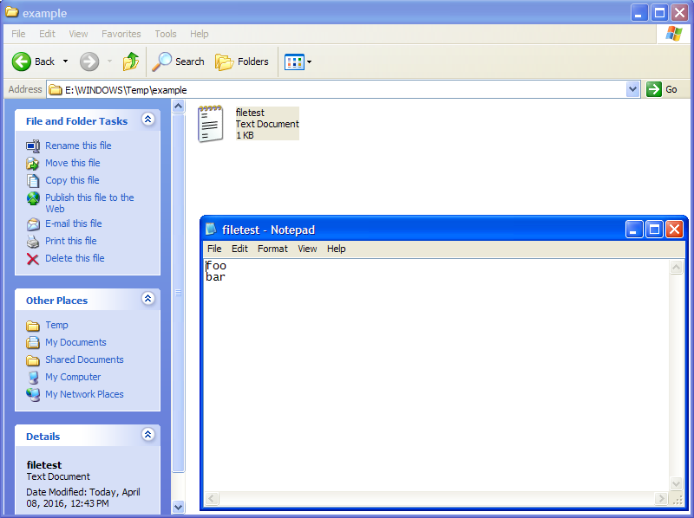
Output
>>>
no temp directory available
*** current temporary directory
E:\WINDOWS\Temp
*** creating example directory...
*** new working directory:
E:\WINDOWS\Temp\example
*** original directory listing:
[]
*** creating test file...
*** updated directory listing:
['test']
*** renaming 'test' to 'filetest.txt'
*** updated directory listing:
['filetest.txt']
*** full file pathname:
E:\WINDOWS\Temp\example\filetest.txt
*** (pathname, basename) ==
('E:\\WINDOWS\\Temp\\example', 'filetest.txt')
*** (filename, extension) ==
('filetest', '.txt')
*** displaying file contents:
foo
bar
*** deleting test file
*** updated directory listing:
[]
*** deleting test directory
*** DONE
Snap before deleting

Slide 18
The shutil Module
The shutil module offers a number of high-level operations on files and collections of files.
In particular, functions are provided which support file copying and removal.
For operations on individual files, see also the os module.

Slide 19
Executing Non-Python Programs
os module provides several functions to run non-python programs such as binary executables and shell scripts
All that is required is
A valid execution environment
Permissions to file access and execution
Shell scripts must be able to access their interpreters
Binaries must be accessible

Slide 20
os Module Functions for Running External Programs
os Module Function | Description
system(cmd) | Execute program cmd given as string, wait for program completion, and return the exit code (on Windows, the exit code is always 0)
fork() | Create a child process that runs in parallel to the parent process [usually used with exec*()]; return twice... once for the parent and once for the child (Unix/Linux Only)
execl(file, arg0, arg1, ...) | Execute file with argument list arg0, arg1, etc.
execv(file, arglist) | Same as execl() except with argument vector (list or tuple) arglist

Slide 21
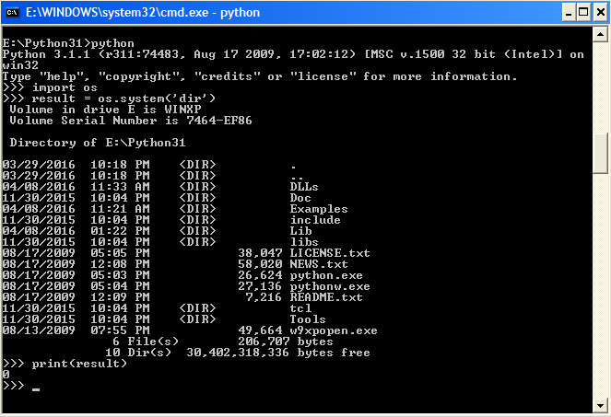
Example: os.system()

Slide 22
Executable Object BIFs
Built-in Function or Statement | Description
compile(string, file, type) | Creates a code object from string of type type; file is where the code originates from (usually set to ""). The type argument specifies what kind of code must be compiled; it can be 'exec' if source consists of a sequence of statements, 'eval' if it consists of a single expression, or 'single' if it consists of a single interactive statement
eval(obj, globals=globals(), locals=locals()) | Evaluates obj, which is either an expression compiled into a code object or a string expression; global and/or local namespace may also be provided
exec (obj) | Executes obj,a single Python statement or set of statements, either in code object or string format; obj may also be a file object (opened to a valid Python script)
Refer: https://docs.python.org/3/library/functions.html

Slide 23
Examples of Executable BIFs
>>> code = """
def gcd(x, y):
while y != 0:
(x, y) = (y, x % y)
return x
print('GCD Calculator')
a = int(input('Enter A : '))
b = int(input('Enter B : '))
print(gcd(a, b))
"""
>>> executable = compile(code, '', 'exec')
>>> exec(executable)
GCD Calculator
Enter A : 15
Enter B : 45
15

Slide 24
Executing Other Python Programs
Other python programs can be executed by calling execfile() in python 2.7.x or exec() in python 3.x from with in the function
>>> exec(open('E:\Python31\Examples\height_of_tree.py').read())
Enter the angle in degrees: 45
Enter the distance in meters : 76
Height of the tree will be approximately 76.00 meters

Slide 25
Module subprocess
The subprocess module provides a consistent interface to creating and working with additional processes.
It offers a higher-level interface than some of the other available modules, and is intended to replace functions such as:
os.system(),
os.spawn*(),
os.popen*(),
popen2.*()
commands.*()

Slide 26
Running External Command
To run an external command without interacting with it, such as one would do with os.system(), use the call() function
import subprocess
subprocess.call(['ls', '-l'], shell=True)
subprocess.call('ls -l')
subprocess.call('ls -l‘, shell=True)
subprocess.call([‘ls’, ‘-l’])
This will not work because subprocess will look for executable file called ‘ls –l’ which obviously is not found
Here subprocess will run this in the shell, ‘ls –l’ is passed as a shell command string
‘-l’ is passed as command line argument
Notes:
(srikanth-sharath).pdf in directory references

Slide 27
Capturing Output
Use check_output() to capture the output for later processing
import subprocess
output = subprocess.check_output(['ls', '-1'])
print 'Have %d bytes in output' % len(output)
print output

Slide 28
Python Iterators
Python iter() converts a container into an iterator
next() functions fetches a next item from an iterator
To create a Python iterator object, you will need to implement two methods in your iterator class.
__iter__: This returns the iterator object itself and is used while using the "for" and "in" keywords.
__next__: This returns the next value.
To prevent infinite iterations raise StopIteration error once all the objects have been looped through
Manual implementation

Slide 29
Python Generators
Python generator gives us an easier way to create python iterators.
This is done by defining a function but instead of the return statement returning from the function, use the "yield" keyword.

Slide 30
Decorators
A decorator in Python is a callable Python object that is used to modify a function, method or class definition.
The original object, the one which is going to be modified, is passed to a decorator as an argument.
The decorator returns a modified object, e.g. a modified function, which is bound to the name used in the definition.

Slide 31
Example
def our_decorator(func):
def function_wrapper(x):
print("Before calling " + func.__name__)
func(x)
print("After calling " + func.__name__)
return function_wrapper
def foo(x):
print("Hi, foo has been called with " + str(x))
print("We call foo before decoration:")
foo("Hi")
print("We now decorate foo with f:")
foo = our_decorator(foo)
print("We call foo after decoration:")
foo(42)
We call foo before decoration:
Hi, foo has been called with Hi
We now decorate foo with f:
We call foo after decoration:
Before calling foo
Hi, foo has been called with 42
After calling foo
Notes:
If you look at the following output of the previous program, you can see what's going on. After the decoration "foo = our_decorator(foo)", foo is a reference to the 'function_wrapper'. 'foo' will be called inside of 'function_wrapper', but before and after the call some additional code will be executed, i.e. in our case two print functions.

Slide 32
Example Continued..
The decoration occurrs in the line before the function header. The "@" is followed by the decorator function name.
We will rewrite now our initial example. Instead of writing the statement
foo = our_decorator(foo) we can write
@our_decorator

Slide 33
Example Continued..
def our_decorator(func):
def function_wrapper(x):
print("Before calling " + func.__name__)
func(x)
print("After calling " + func.__name__)
return function_wrapper
@our_decorator
def foo(x):
print("Hi, foo has been called with " + str(x))
foo("Hi")

Slide 34
Checking Arguments with Decorator
The following program uses a decorator function to ensure that the argument passed to the function factorial is a positive integer:
def argument_test_natural_number(f):
def helper(x):
if type(x) == int and x > 0:
return f(x)
else:
raise Exception("Argument is not an integer")
return helper
@argument_test_natural_number
def factorial(n):
if n == 1:
return 1
else:
return n * factorial(n-1)
for i in range(1,10):
print(i, factorial(i))
print(factorial(-1))

Slide 35
Counting Function Calls with Decorators
The following example uses a decorator to count the number of times a function has been called. To be precise, we can use this decorator solely for functions with exactly one parameter:
def call_counter(func):
def helper(x):
helper.calls += 1
return func(x)
helper.calls = 0
return helper
@call_counter
def succ(x):
return x + 1
print(succ.calls)
for i in range(10):
print(succ(i))
print(succ.calls)

Slide 36
Parameterized Decorators
The example shows how a parameter can be passed to a decorator:
def greeting(expr):
def greeting_decorator(func):
def function_wrapper(x):
print(expr + ", " + func.__name__ + " returns:")
func(x)
return function_wrapper
return greeting_decorator
@greeting("καλημερα")
def foo(x):
print(42)
foo("Hi")

Slide 37
Class as a Decorator
The example shows how a class can be used as a decorator
__call__ function holds an important role here
def decorator1(f):
def helper():
print("Decorating", f.__name__)
f()
return helper
@decorator1
def foo():
print("inside foo()")
foo()
class decorator2(object):
def __init__(self, f):
self.f = f
def __call__(self):
print("Decorating", self.f.__name__)
self.f()
@decorator2
def foo():
print("inside foo()")
foo()

Slide 38
Class Attributes
Class attributes can be listed through dir()
The dictionary form of the class can be obtained through vars()
Example:
dir(obj)

Slide 39
Composition
Composition is another way of extending a class by explicitly creating an instance of a class inside a sub-class
It creates ‘has-a’ relationship
Inheritance Vs Composition
In Inheritance, a class is inherited (extended) by a new sub-class that will add custom attributes and behavior to the inherited ones
In Composition, a class is utilized by creating an instance of it, and including that instance inside another larger object

Slide 40
Example: Composition
class math:
def __init__(self, x, y):
self.x = x;
self.y = y;
def add(self):
return self.x + self.y
def subtract(self):
return seld.x - self.y
class math2:
def __init__(self, x, y):
self.x = x
self.y = y
def multiply(self):
return self.x * self.y
def divide(self):
return self.x/self.y
class math3:
def __init__(self, x, y):
self.x = x
self.y = y
self.m1 = math(x,y)
self.m2 = math2(x,y)
def power(self):
return self.x ** self.y
def add(self):
return self.m1.add()
def subtract(self):
return self.m1.subtract()
def multiply(self):
return self.m2.multiply()
Composition
Create a unit test for this code.
How would you achieve the same through inheritance?
Notes:
https://www.eduonix.com/blog/software-development/learn-object-oriented-programming-in-python-composition/

Slide 41
Delegation
Delegate = entrusting the responsibility to another person
Delegation is a special form of composition, with a single embedded object managed by a wrapper (sometimes called a proxy) class that retains most or all of the embedded object’s interface.
# Simple demonstration of the Proxy pattern.
class Implementation:
def f(self):
print("Implementation.f()")
def g(self):
print("Implementation.g()")
def h(self):
print("Implementation.h()")
class Proxy:
def __init__(self):
self.__implementation = Implementation()
# Pass method calls to the implementation:
def f(self): self.__implementation.f()
def g(self): self.__implementation.g()
def h(self): self.__implementation.h()
p = Proxy()
p.f(); p.g(); p.h()

Slide 42
Delegation
# Simple demonstration of the Proxy pattern.
class Implementation2:
def f(self):
print("Implementation.f()")
def g(self):
print("Implementation.g()")
def h(self):
print("Implementation.h()")
class Proxy2:
def __init__(self):
self.__implementation = Implementation2()
def __getattr__(self, name):
return getattr(self.__implementation, name)
p = Proxy2()
p.f(); p.g(); p.h();
Composition
Delegated

Slide 43
Mixins – Multiple Inheritance
Mixin class is a class that has been inherited from multiple superclasses
In a class statement, more than one superclass can be listed in parentheses in the header line.
When you do this, you leverage multiple inheritance—the class and its instances inherit names from all the listed superclasses.
Notes:
http://www.python-course.eu/python3_multiple_inheritance.php

Slide 44
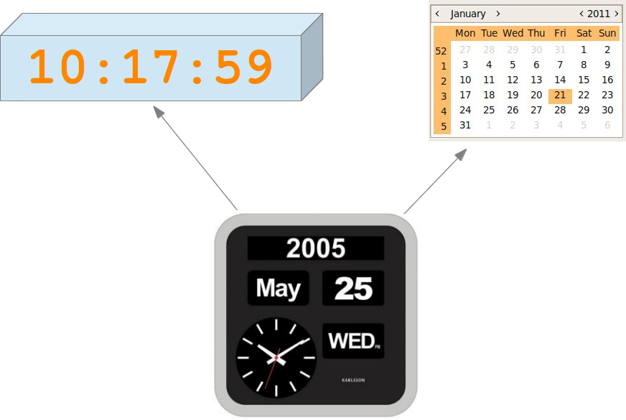
Example
Say we have two classes: clock and calendar. Let’s create a clock_calendar class that inherits from clock and calender classes as shown:

Slide 45
Example
class Clock(object):
def __init__(self, hours, minutes, seconds): pass
def set_Clock(self, hours, minutes, seconds): pass
def __str__(self): pass
def tick(self): pass
class Calendar(object):
months = (31,28,31,30,31,30,31,31,30,31,30,31)
date_style = "British"
@staticmethod
def leapyear(year):
def __init__(self, d, m, y):
def set_Calendar(self, d, m, y):
def __str__(self):
def advance(self):
from clock import Clock
from calendar import Calendar
class CalendarClock(Clock, Calendar):
def __init__(self,day, month, year, hour, minute, second):
def tick(self):
def __str__(self):
Multiple Inheritance
Notes:
Mindful_examples\Class – OOP\mixin_demo

Slide 46
Python Descriptors
Python descriptor protocol is simply a way to specify what happens when an attribute is referenced on a model.
It allows a programmer to easily and efficiently manage attribute access:
set
get
delete
Create a class and override any of the descriptor methods: __set__, __ get__, and __delete__.
If any of those methods are defined for an object, it is said to be a descriptor.
This method is used when the same descriptor is needed across many different classes and attributes, for example, for type validation.

Slide 47
Descriptor Protocol
descr.__get__(self, obj, type=None) -> value
descr.__set__(self, obj, value) -> None
descr.__delete__(self, obj) -> None
Let’s implement a descriptor

Slide 48
@property
In Python, property() is a built-in function that creates and returns a property object.
A property object has three methods, getter(), setter(), and deleter() to specify fget, fset and fdel at a later point.
The signature of this function is
property(fget=None, fset=None, fdel=None, doc=None)
fget is function to get value of the attribute
fset is function to set value of the attribute
fdel is function to delete the attribute
doc is a string (like a comment).

Slide 49
Reading data/tables from HTML
Can be achieved using read_html() from pandas
Example:
import pandas as pd url = r'https://en.wikipedia.org/wiki/List_of_S%26P_500_companies’
tables = pd.read_html(url) # Returns list of all tables on page
sp500_table = tables[0] # Select table of interest

Slide 50
Working with JSON
JSON files can be read through the pandas library using the read_json()
import pandas as pd
data = pd.read_json(‘xyz.json’)

